Slide 1
Nitrates Background

Slide 2
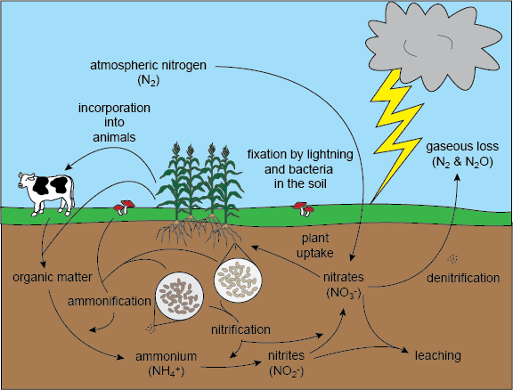
What are nitrates?
Nitrogen is found everywhere on earth. It is in the air we breathe, the ground we walk on, and the water we drink. Nitrogen takes many different forms, combining with other elements to make compounds.
Nitrogen can be in many different compounds. The nitrogen cycle describes the flow of nitrogen on earth as it is converted from one compound to another, playing different roles in different components of earth.

Slide 3
What are nitrates?
Some common compounds that contain nitrogen are:
  N₂: Nitrogen gas, makes up 78% of the atmosphere
  CN-: Cyanide, a compound poisonous to living organisms
  NH₃: Ammonia, used in many cleaning products
  NH₄+: Ammonium, component of decomposition, plant nutrient in a different form
  NO₂-: Nitrite, part of decomposition
  NO₃-: Nitrate, part of decomposition, important nutrient for plants

Slide 4
What are nitrates?
Some common compounds that contain nitrogen are:
  N₂: Nitrogen gas, makes up 78% of the atmosphere
  CN-: Cyanide, a compound poisonous to living organisms
  NH₃: Ammonia, used in many cleaning products
  NH₄+: Ammonium, component of decomposition, plant nutrient in a different form
  NO₂-: Nitrite, part of decomposition
  NO₃-: Nitrate, part of decomposition, important nutrient for plants

Slide 5
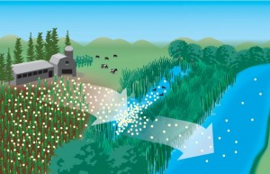
Why are they important?
While nitrogen is important to plants, especially in the form of nitrate, too much of it can become a bad thing.
Most fertilizers contain nitrate (NO₃-) and sometimes ammonium (NH₄+) to provide extra nutrients to plants.
When farmers put fertilizer on fields, some of the nitrates are incorporated into the plant and used for its essential functions. However, a lot of the fertilizer applied to the field sits in or on the soil. When it rains the soil absorbs the water. But, the soil can only absorb so much water. Eventually, the water starts to run over the fields and downhill, bringing the excess fertilizer with it. This water then ends up in local lakes, rivers, and streams, eventually flowing into the ocean.
Notes:
Picture source:http://blogs.edf.org/growingreturns/2014/08/06/lake-eries-fertilizer-problem-isnt-over-but-were-working-on-it/

Slide 6
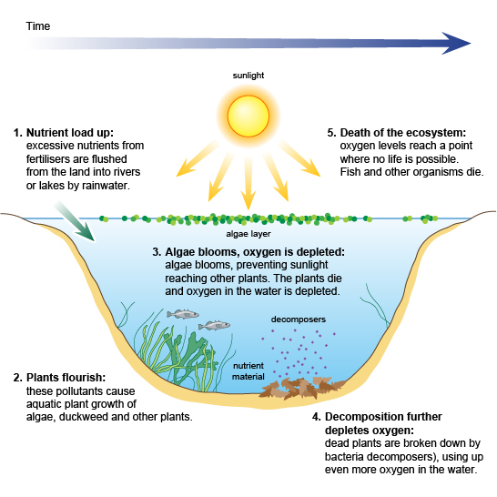
Why are they important?
When this happens, the water is filled with too much nitrogen. This excess of nutrients can lead to eutrophication.
First, plants flourish and an overgrowth of algae coats the top of the lake. The algae block the sunlight, and plants on the bottom of streambed or ocean floor die.
The decomposition of these plants uses a lot of oxygen dissolved in the water. Soon, there is not enough oxygen dissolved in the water for other organisms to live there. Some of them escape and others die.
The organisms that die are then decomposed, taking the rest of the oxygen out of the water. This creates “dead zones” or areas where no life can be sustained. This eutrophication process can happen in any body of water.
Notes:
Picture source: http://www.bbc.co.uk/schools/gcsebitesize/science/edexcel/problems_in_environment/pollutionrev4.shtml

Slide 7
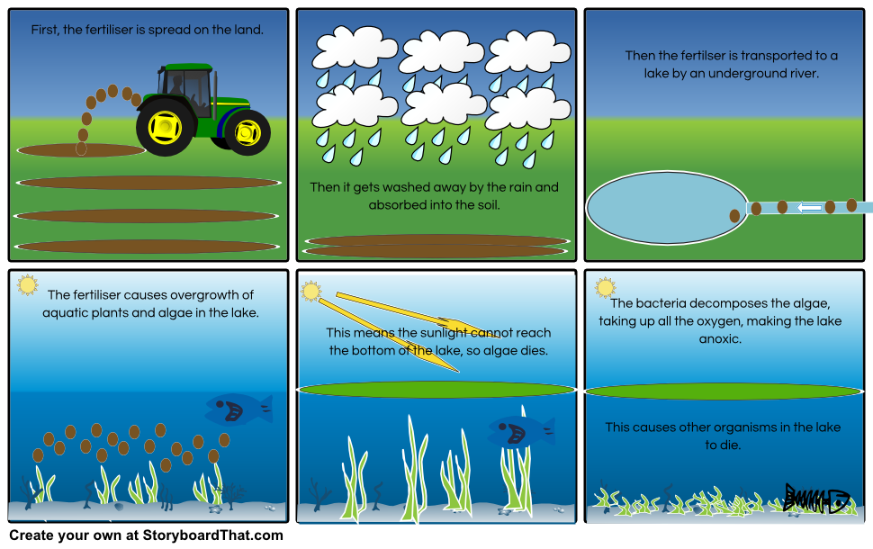
Why are they important?
Even if excess nitrate in water doesn’t cause eutrophication, too much nitrate in the water can lead to toxic levels deadly to fish and other aquatic organisms.
Notes:
Picture source:http://www.storyboardthat.com/userboards/quenton4/the-eutrophication-process

Slide 8
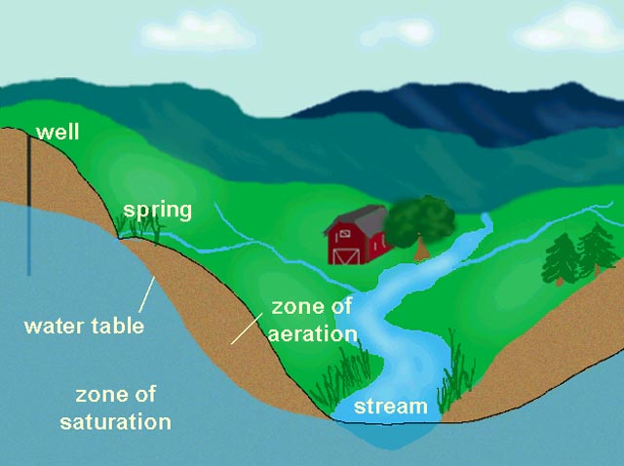
Why are they important?
Not only are excess nitrates bad for aquatic ecosystems and other parts of the environment, excess nitrates in drinking water can be bad for human health.
Nitrate can find its way into drinking water in a very similar way to how it reaches rivers and streams. While some nitrates from fertilizer on the landscape are used by plants, or run off into nearby bodies of water, some of it is carried by water deep into the soil, reaching underground water.
This underground water (the water table) is used as a source of drinking water from wells or water treatment plants. Drinking water sources can also be rivers and streams, which gain excess nitrates as described earlier.

Slide 9
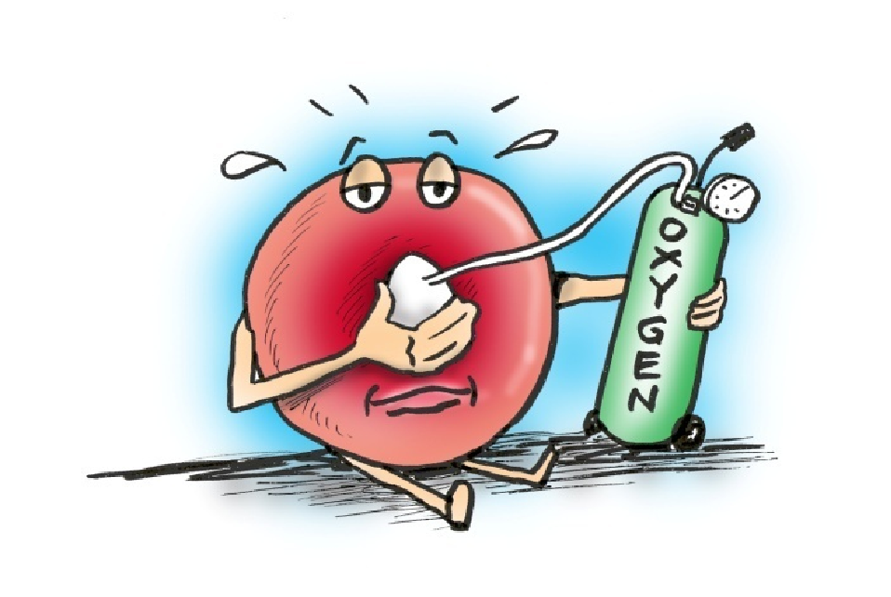
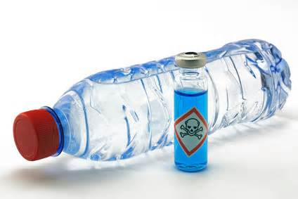
Nitrates and Human Health
Nitrates in water are particularly dangerous to babies and the elderly. It can cause methemoglobinemia, meaning that blood can’t carry sufficient oxygen to cells.
They can also cause nitrate poisoning which can lead to increased heart rate and respiration.

Slide 10


Why study Nitrates in Water??
Because they are important to our health and the health of the environment!

Slide 11
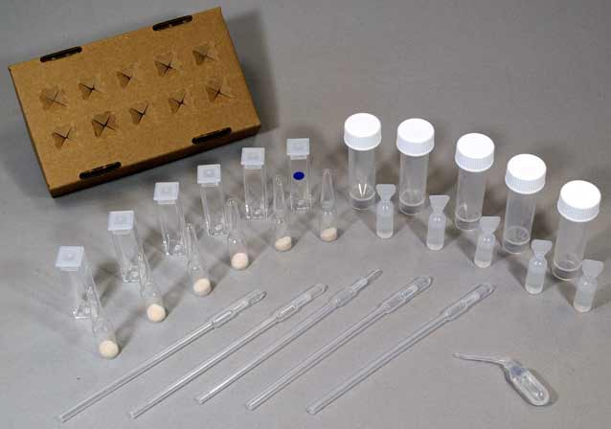
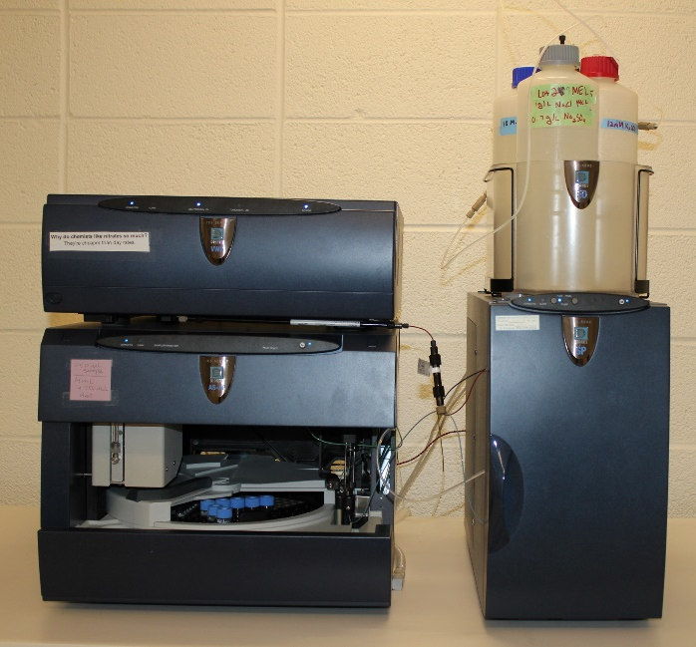
How do we detect them?
You cannot detect the presence of nitrates just be looking for them with the naked eye, so we must use other ways to test for them.
Nitrate Test Kits- portable test kit that allows you to test nitrate levels from multiple water sources. Colorimetric scale gives you nitrate concentration.
Ion Chromatography – type of chromatography that separates ions based on their affinity to the ion exchanger in an Ion Chromatograph.

Slide 12
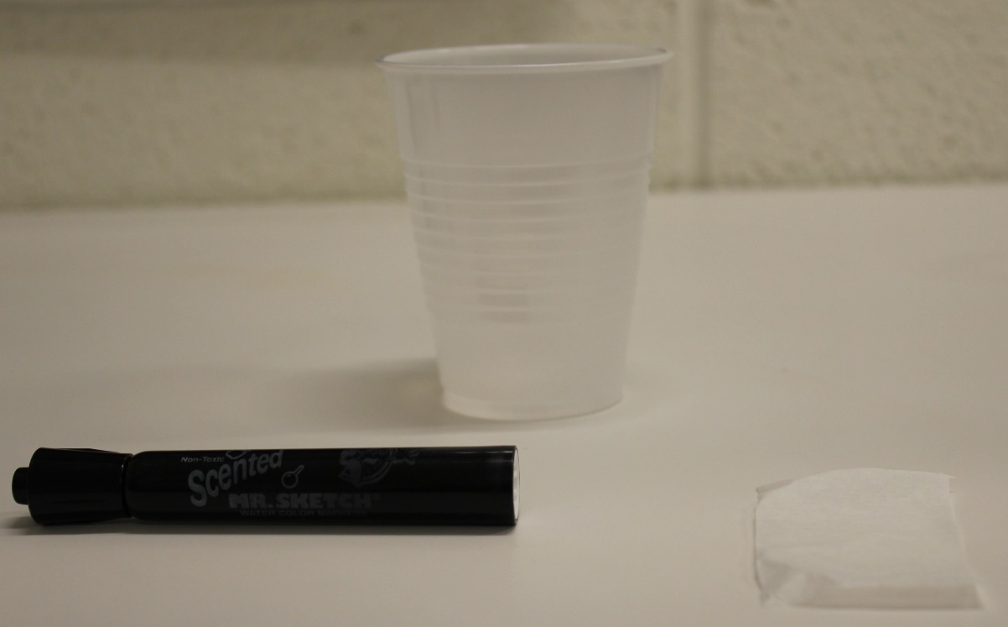
What is chromatography?
Chromatography- a set of laboratory techniques that is designed to separate mixtures.
Example: Paper Chromatography
  The ink used in black magic markers is actually composed of several different colors. We can separate the ink colors by performing paper chromatography.
  Supplies:
    Coffee filter (Cut into a rectangular piece)
    Black magic marker
    Beaker or plastic cup
    Water
Notes:
https://www.youtube.com/watch?v=SnbXQTTHGs4

Slide 13
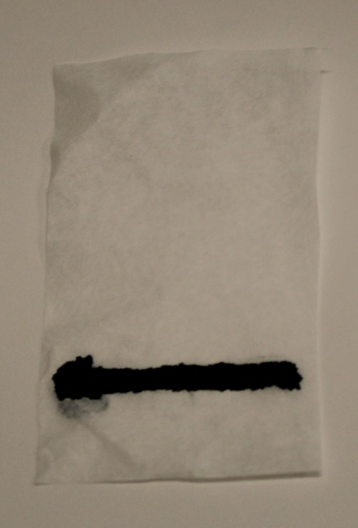
Paper Chromatography
Using the magic marker, draw a line about 1 inch from the bottom of a rectangular piece of coffee filter.
Notes:
Khan Academy Chromatography Video: https://www.youtube.com/watch?v=SnbXQTTHGs4

Slide 14
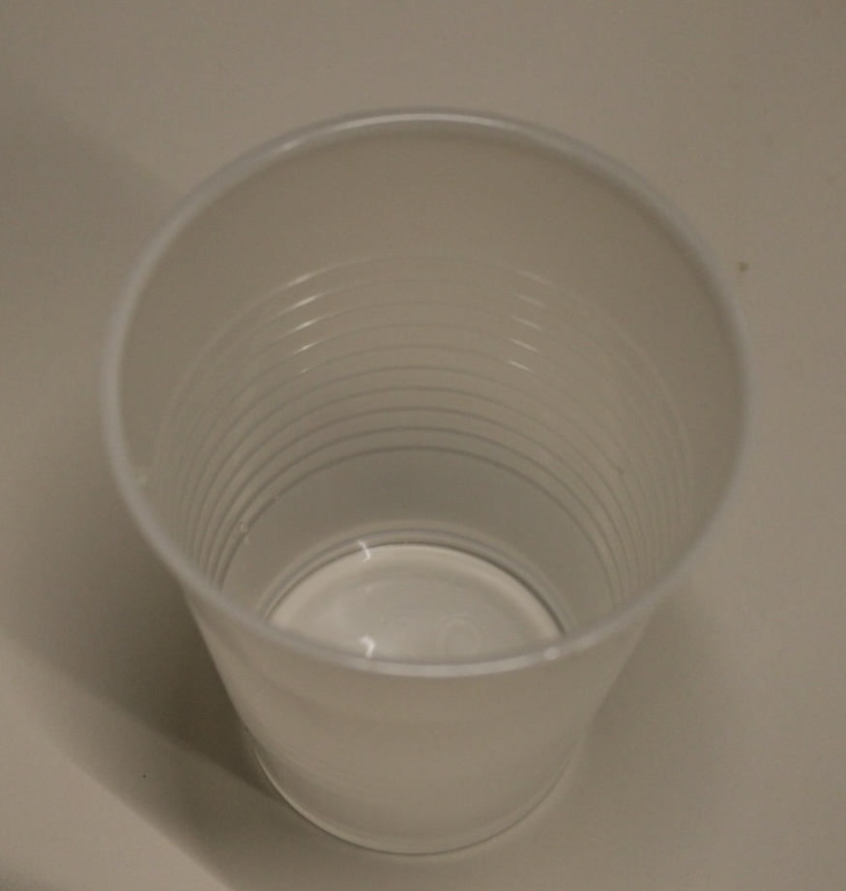
Paper Chromatography
2. Put a small amount of water in the beaker/cup so that it will cover the bottom of the coffee filter, but not touch your marker line.
Notes:
Khan Academy Chromatography Video: https://www.youtube.com/watch?v=SnbXQTTHGs4

Slide 15
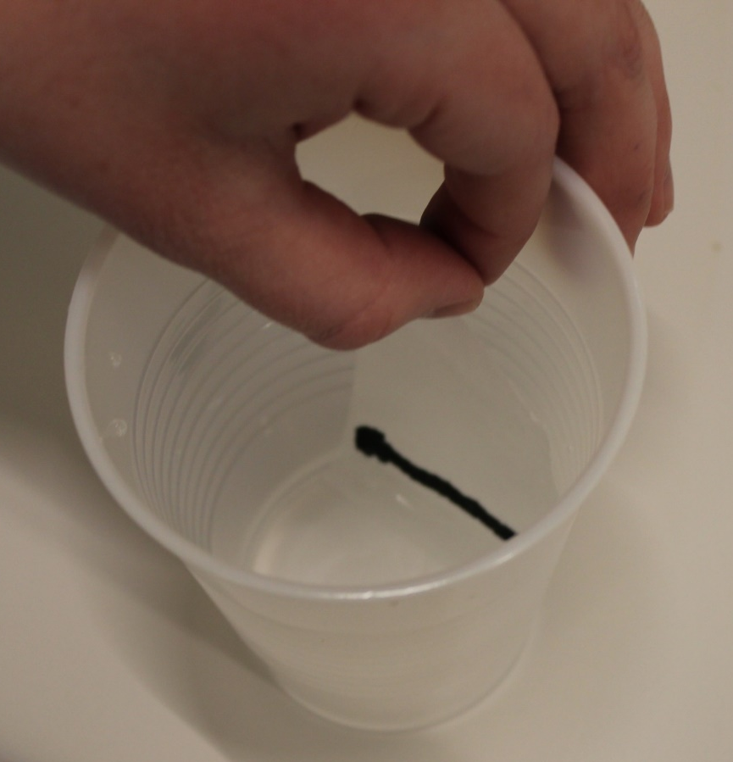
Paper Chromatography
3. Place your piece of coffee filter in the beaker/cup containing water with the side with the marker line being closest to the water.
Notes:
Khan Academy Chromatography Video: https://www.youtube.com/watch?v=SnbXQTTHGs4

Slide 16
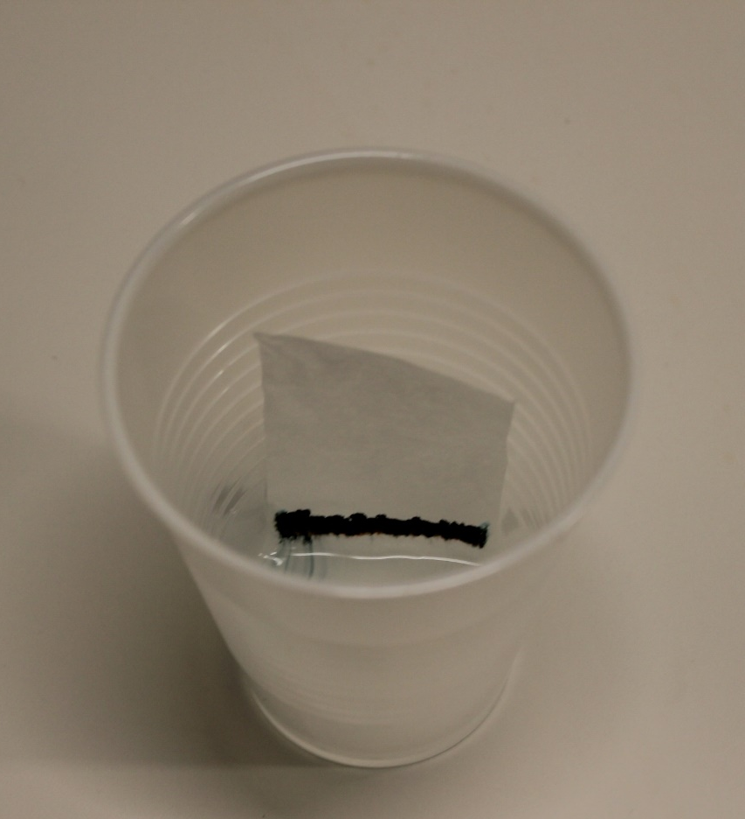
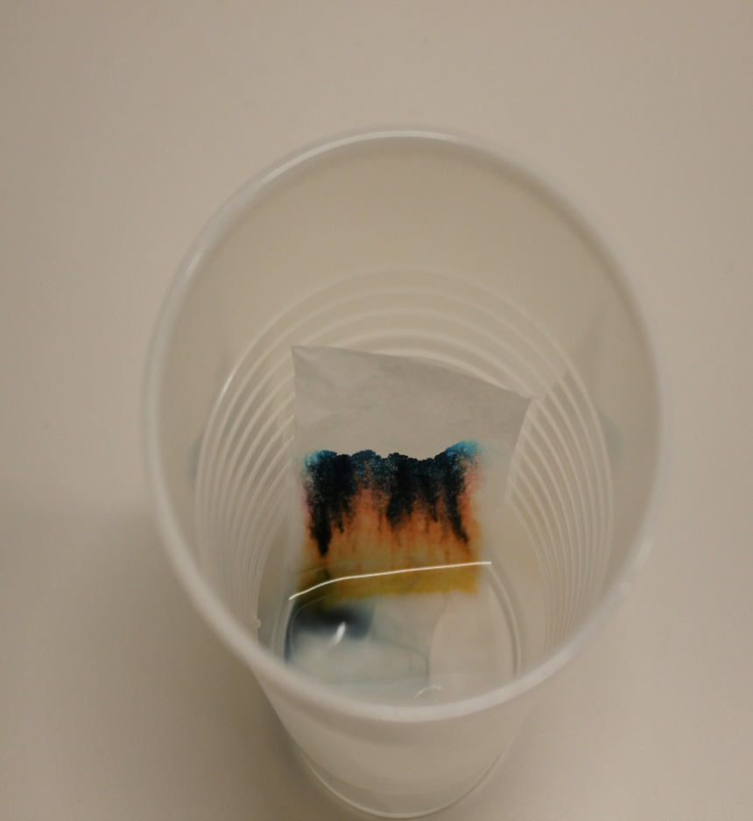
Paper Chromatography
4. Let sit for ~20 minutes and watch the colors separate!
Notes:
Khan Academy Chromatography Video: https://www.youtube.com/watch?v=SnbXQTTHGs4

Slide 17
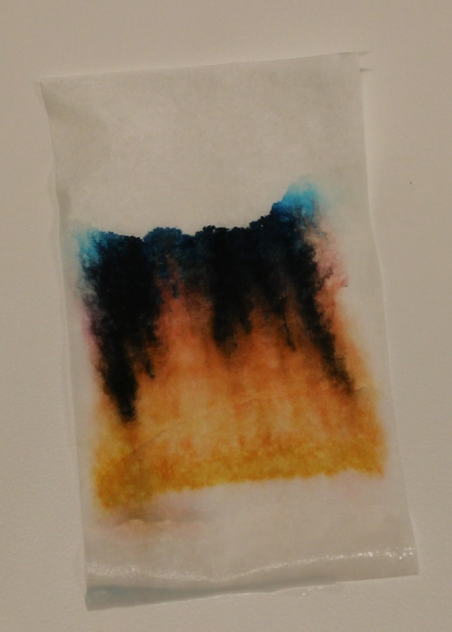
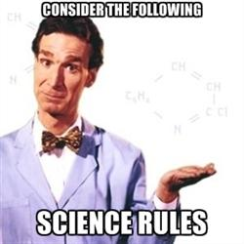
Paper Chromatography
We are now able to distinguish the separate colors of the ink. The black ink is actually made up of blue, orange, yellow, and red.
Notes:
Khan Academy Chromatography Video: https://www.youtube.com/watch?v=SnbXQTTHGs4

Slide 18
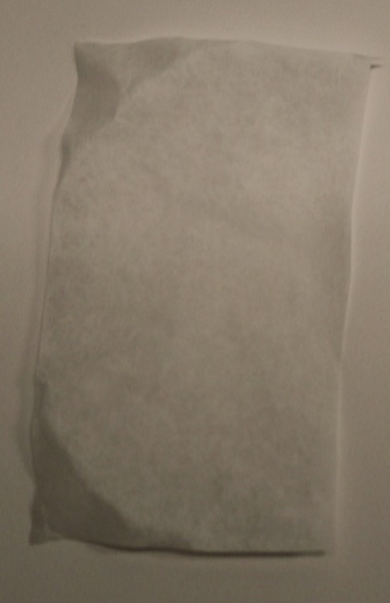
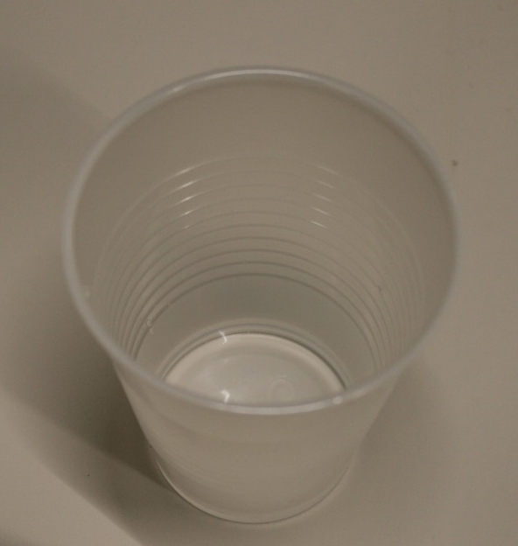

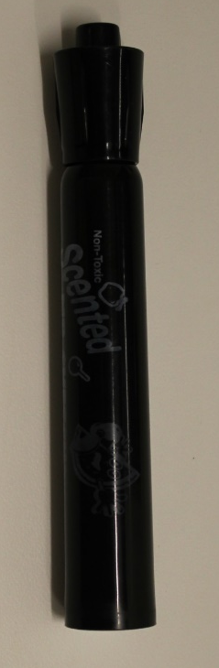
Paper Chromatography
In chromatography a mixture is separated by distributing the parts between two phases- the stationary phase and the mobile phase. In this example the coffee filter is the stationary phase, because it remains fixed in place. The water in the cup is the mobile phase, because it travels up the coffee filter to separate the ink. The ink in the magic marker is the mixture we want to separate, and our eyes act as a detector of the colors.
Mobile
Phase
Stationary Phase
Detector
Mixture
Notes:
Khan Academy Chromatography Video: https://www.youtube.com/watch?v=SnbXQTTHGs4

Slide 19

Ion-Exchange Chromatography
Ion Chromatography is another form of chromatography similar to paper chromatography, only you are separating a mixture of ions, instead of colors in ink.
Sample
Injection
Valve
Autosampler
Eluent
(Mobile Phase)
IC
Pump
UV Detector
Anion Exchange
Column
Data Acquisition
Waste
Notes:
http://dictionary.reference.com/browse/ion
http://serc.carleton.edu/microbelife/research_methods/biogeochemical/ic.html

Slide 20

Ion-Exchange Chromatography
The sample that goes into the Ion Chromatograph (in this case your water sample) is just like the ink in the marker.
Sample
Injection
Valve
Autosampler
Eluent
(Mobile Phase)
IC
Pump
=
Sample
UV Detector
Anion Exchange
Column
Data Acquisition
Waste
Notes:
http://dictionary.reference.com/browse/ion
http://serc.carleton.edu/microbelife/research_methods/biogeochemical/ic.html

Slide 21

Ion-Exchange Chromatography
The eluent, or mobile phase, is similar to the cup of water. However in this case a salt mixture will be used instead.
Sample
Injection
Valve
Eluent
(Mobile Phase)
Autosampler
Eluent
(Mobile Phase)
IC
Pump
=
UV Detector
Anion Exchange
Column
Data Acquisition
Waste
Notes:
http://dictionary.reference.com/browse/ion
http://serc.carleton.edu/microbelife/research_methods/biogeochemical/ic.html

Slide 22
Ion Chromatography
There was no “pump” component to the paper chromatography. However in Ion Chromatography this simply functions to distribute the mobile phase over the sample.
Sample
Injection
Valve
Autosampler
Eluent
(Mobile Phase)
IC
Pump
UV Detector
Anion Exchange
Column
Data Acquisition
Waste
Notes:
http://dictionary.reference.com/browse/ion
http://serc.carleton.edu/microbelife/research_methods/biogeochemical/ic.html

Slide 23
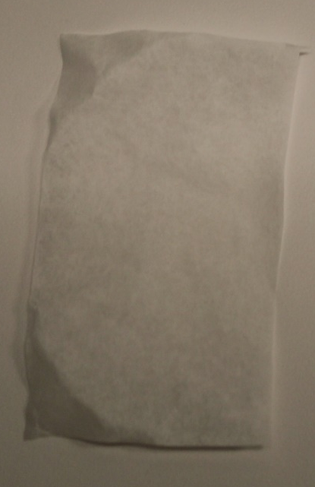
Ion Chromatography
The solid-phase in Ion Chromatography is called a column. It is similar to the coffee filter in the paper chromatography example.
Sample
Injection
Valve
Autosampler
Eluent
(Mobile Phase)
=
IC
Pump
Anion Exchange
Column
UV Detector
Anion Exchange
Column
Data Acquisition
Waste
Notes:
http://dictionary.reference.com/browse/ion
http://serc.carleton.edu/microbelife/research_methods/biogeochemical/ic.html

Slide 24
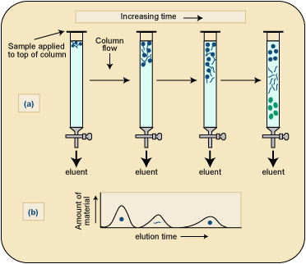
Ion Chromatography
The column is a very important part on an Ion Chromatograph. Inside of the column is a resin that is made to attract a certain type of ion. Nitrate ions have a negative charge and the resin in the column we will use has a positive charge. When the nitrate ions pass through the column, they will be attracted by the positively charged resin. Eventually, the mobile phase pushes the ions off the column and to the detector so that we can quantify them.
http://d32ogoqmya1dw8.cloudfront.net/images/microbelife/research_methods/biogeochemical/ic_instrumentation.gif
Notes:
http://dictionary.reference.com/browse/ion
http://serc.carleton.edu/microbelife/research_methods/biogeochemical/ic.html

Slide 25

Ion Chromatography
Nitrates cannot by seen with the naked eye, so the UV detector is able to identify the nitrates present in the sample and convert this into data that we can read. The UV detector is similar to our eyes in the paper chromatography example, however it uses ultraviolet light to detect the nitrates in the sample.
Sample
Injection
Valve
Autosampler
Eluent
(Mobile Phase)
=
UV Detector
IC
Pump
UV Detector
Anion Exchange
Column
Data Acquisition
Waste
Notes:
http://dictionary.reference.com/browse/ion
http://serc.carleton.edu/microbelife/research_methods/biogeochemical/ic.html

Slide 26
Ion-Exchange Chromatography
The nitrate data is presented as what is known as a chromatogram, which looks like a series of peaks. We can calculate the area under the peaks, and utilize a technique called a calibration curve in order to determine the nitrate concentration in our water sample.
Sample
Injection
Valve
Example Nitrate Peak
Autosampler
Eluent
(Mobile Phase)
IC
Pump
UV Detector
Anion Exchange
Column
Peak area = 100
Data Acquisition
Waste
Notes:
http://dictionary.reference.com/browse/ion
http://serc.carleton.edu/microbelife/research_methods/biogeochemical/ic.html

Slide 27
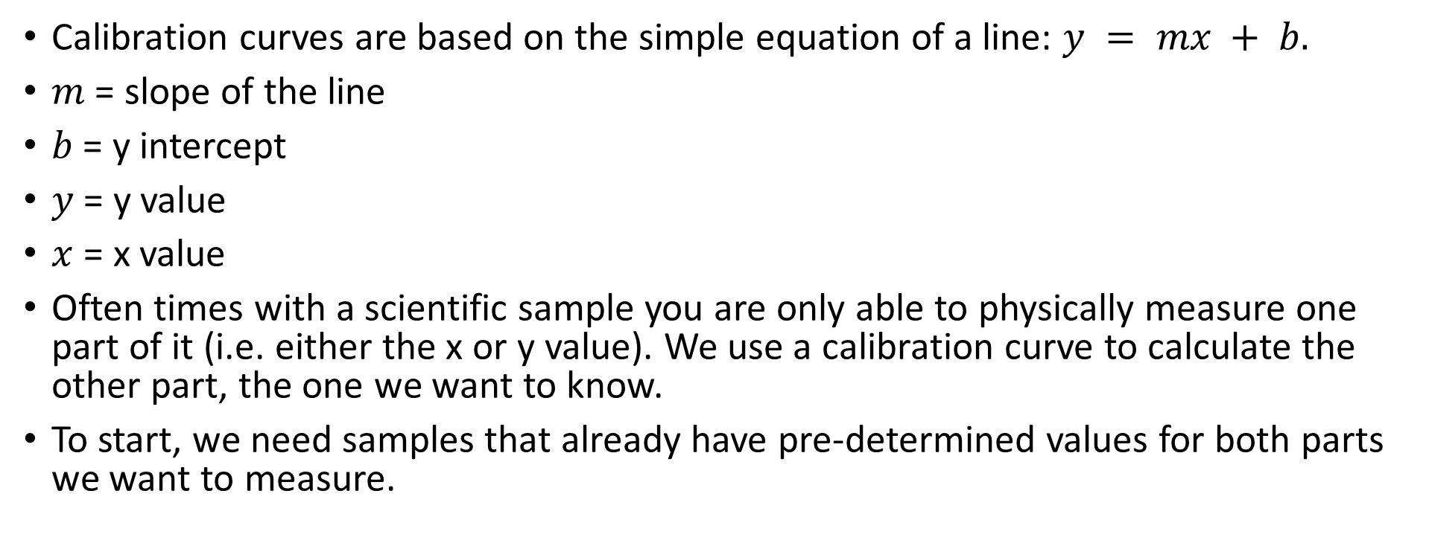
Calibration Curves
Calibration curves are based on the simple equation of a line: $y = mx + b.$
$m$ = slope of the line
$b$ = y intercept
$y$ = y value
$x$ = x value
Often times with a scientific sample you are only able to physically measure one part of it (i.e. either the x or y value). We use a calibration curve to calculate the other part, the one we want to know.
To start, we need samples that already have pre-determined values for both parts we want to measure.

Slide 28
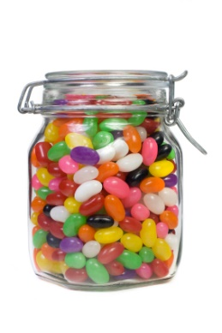
Pieces of Candy in a Jar Example
There is a contest at school where you can win $100 dollars if you correctly guess the number of pieces of candy in a jar. In order to help you guess, the teachers have put out five other jars of varying sizes that are also filled with candy. Each of the five jars is labeled with the volume of the jar, and the pre-determined number of candy pieces that will fit in that size jar.
You want the best chance of winning and you are not allowed to count the candy by hand, so instead of just randomly guessing you decide to use a calibration curve to estimate the number of pieces of candy in the prize-winning jar.
?

Slide 29
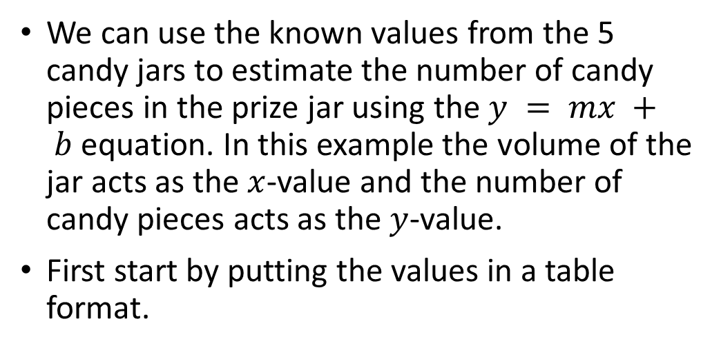
Pieces of Candy in a Jar Example
We can use the known values from the 5 candy jars to estimate the number of candy pieces in the prize jar using the $y = mx + b$equation. In this example the volume of the jar acts as the $x$-value and the number of candy pieces acts as the $y$-value.
First start by putting the values in a table format.
Jar 1: 15 in³
20 pieces
Jar 3: 45 in³
60 pieces
Jar 5: 75 in³
100 pieces
Jar Number | Volume (in3) (x) | # of Candy Pieces (y)
1 | 15 | 20
2 | 30 | 40
3 | 45 | 60
4 | 60 | 80
5 | 75 | 100
Prize Jar | 56 ¼ | ?
Jar 2: 30 in³
40 pieces
Jar 4: 60 in³
80 pieces
Prize Jar: 56 ¼ in³
? pieces

Slide 30
Pieces of Candy in a Jar Example
2. Plot the five known $x$ and $y$-values on a graph.
Jar Number | Volume (in3) (x) | # of Candy Pieces (y)
1 | 15 | 20
2 | 30 | 40
3 | 45 | 60
4 | 60 | 80
5 | 75 | 100
6 | 56 ¼ | ?

Slide 31
Pieces of Candy in a Jar Example
3. Draw a line that best fits through the plotted points on your graph.

Slide 32
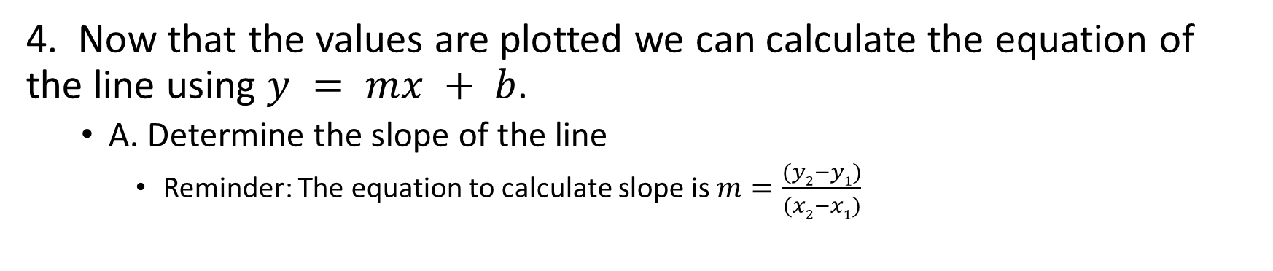
Pieces of Candy in a Jar Example
4. Now that the values are plotted we can calculate the equation of the line using $y = mx + b$.
  A. Determine the slope of the line
    Reminder: The equation to calculate slope is $m=\frac{(y2−y1)}{(x2−x1)}$

Slide 33
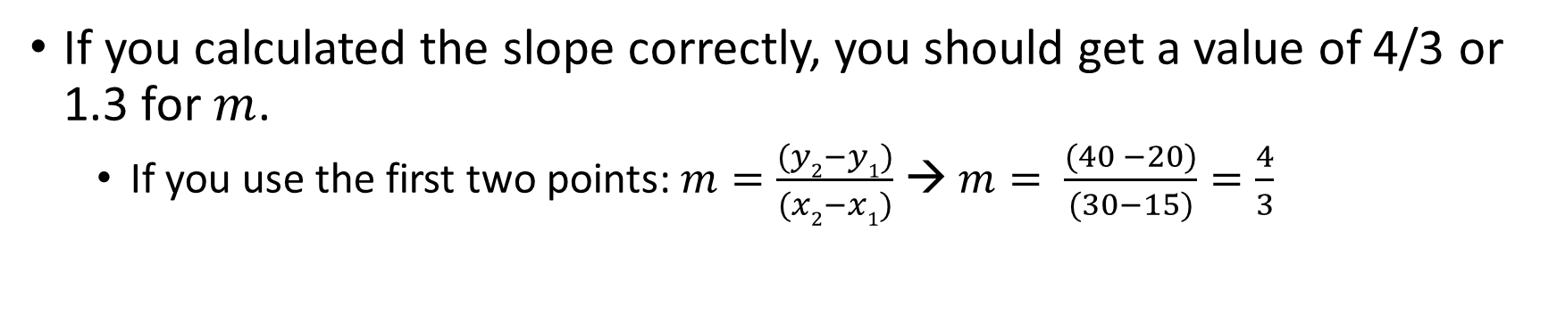
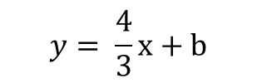
Pieces of Candy in a Jar Example
If you calculated the slope correctly, you should get a value of 4/3 or 1.3 for $m$.
  If you use the first two points: $m=\frac{(y2−y1)}{(x2−x1)}$ → $m= \frac{(40 −20)}{(30−15)}=\frac{4}{3}$
$$y= \frac{4}{3}x+b$$

Slide 34
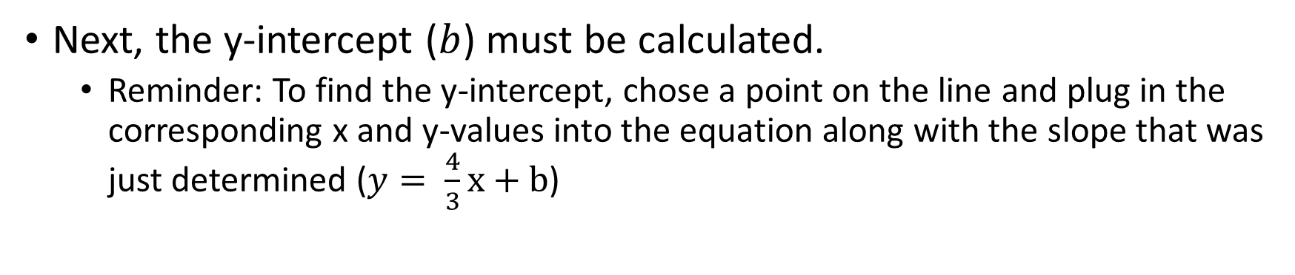
Pieces of Candy in a Jar Example
Next, the y-intercept ($b$) must be calculated.
  Reminder: To find the y-intercept, chose a point on the line and plug in the corresponding x and y-values into the equation along with the slope that was just determined ($y= \frac{4}{3}x+b$)
$$y= \frac{4}{3}x+b$$

Slide 35
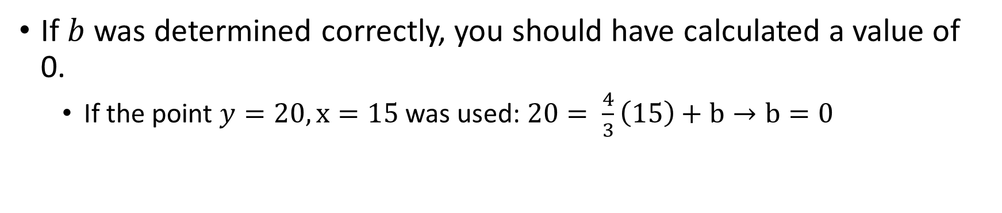
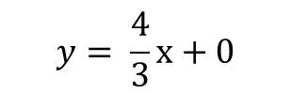
Pieces of Candy in a Jar Example
If $b$ was determined correctly, you should have calculated a value of 0.
  If the point $y=20, x=15$ was used: $20= \frac{4}{3}\left(15\right)+b→b=0$
$$y= \frac{4}{3}x+0$$

Slide 36
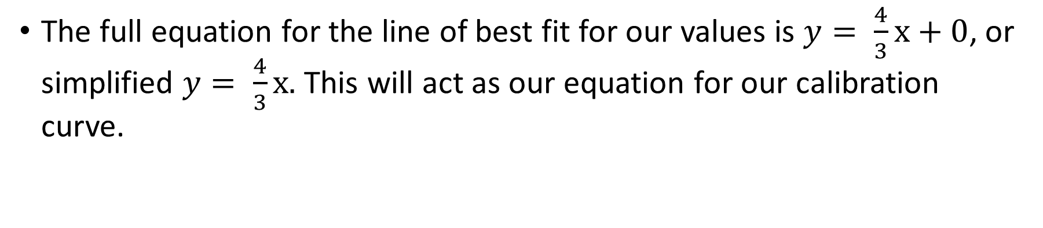
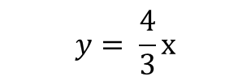
Pieces of Candy in a Jar Example
The full equation for the line of best fit for our values is $y= \frac{4}{3}x+0$, or simplified $y= \frac{4}{3}x.$ This will act as our equation for our calibration curve.
*Note- this equation is just an approximation since it only takes into account 2 points on the line, not all 5*
$$y= \frac{4}{3}x$$
Notes:
*If desired- can also introduce possibility of using a software such as Excel to do calculations so that they are more accurate*

Slide 37
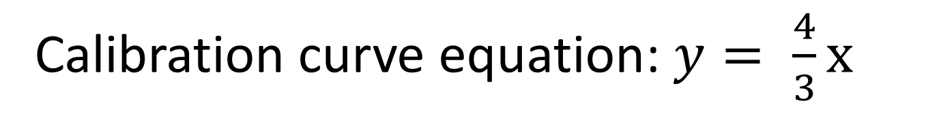
Pieces of Candy in a Jar Example
Since we now have our calibration curve equation, we can solve for any unknown x or y value that we wish to determine. This includes solving for how many pieces of candy are in our prize candy jar.
Calibration curve equation: $y= \frac{4}{3}x$
Jar 6: 56 ¼ in³
? pieces
Solve for the Number of Pieces of Candy in the Prize Jar

Slide 38

Pieces of Candy in a Jar Example
There are 75 pieces of candy in the prize jar. Does this make sense?
Jar 6: 56 ¼ in³
? pieces
$$x=56 \frac{1}{4} {in}^{3}$$
$$y= \frac{4}{3}(56\frac{1}{4} {in}^{3})$$
$$y=75 pieces of candy$$
Notes:
Yes, makes sense because the volume of the prize jar (56.25) is between the two known volumes 45 and 60. So the number of pieces of candy in the prize jar should fall between 60 and 80.

Slide 39
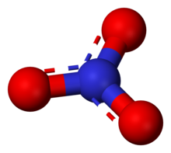
Calibration Curves- Other Uses
If necessary, you could count the candy pieces in the jar by hand to determine the exact amount. However there are many times when you cannot physically count a variable, and a calibration curve is the next best option.
A perfect example of this is calculating the concentration of nitrates in a water sample. Nitrates are too small to see, so they cannot be counted by hand, but they can be calculated using a calibration curve.

Slide 40
Measuring Nitrate Concentrations
When the lab receives a water sample that needs to be tested for nitrates, it is very similar to trying to determine how many pieces of candy were in the prize jar.
Before a random sample is analyzed, water that has a known nitrate concentration is analyzed using an Ion Chromatograph.
The Ion Chromatograph gives us a read-out of nitrate concentration as the area under a nitrate peak.
Although the units are different, the nitrate peak area can be used in a similar way as the volume of the candy jars in order to create a calibration curve, and determine an unknown nitrate concentration in a water sample.
Example Nitrate Peak
Peak area = 100

Slide 41
Nitrate Calibration Curve
Start with a water sample that has been created to have a known concentration of nitrate. This sample is called a standard.
Five different standards, each with a known concentration of nitrate, are run on the Ion Chromatograph. The instrument gives us a peak area for each known concentration of nitrate.
Each of the five known concentrations of nitrate is equivalent to each of the five jars with known amounts of candy.
Each peak area is equivalent to the volume of each jar.

Slide 42
Nitrate Calibration Curve - Example
You have run five different nitrate standards on the Ion Chromatograph and analyzed their peak areas to come up with the data table below. Use the data table in order to create a calibration curve for your five nitrate standards. (Hint: follow the same steps as in the candy jar example).
Known Concentration in Standard (ppm) (x) | Peak Area (y)
2 | 4.236
10 | 21.916
20 | 42.15
50 | 99.535
100 | 195.697

Slide 43
Nitrate Calibration Curve - Example
Plot the data points on a graph.

Slide 44
Nitrate Calibration Curve - Example
2. Draw a line that best fits through the data points.

Slide 45
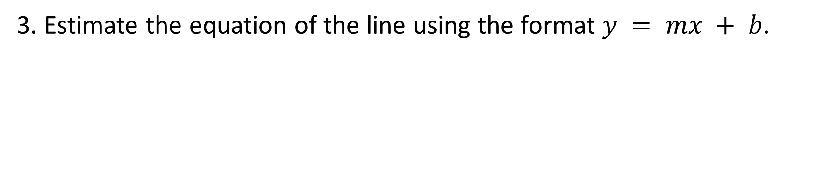

Nitrate Calibration Curve - Example
3. Estimate the equation of the line using the format $y = mx + b$.
$$m = 2.2$$
$$b = − 0.2$$
$$y = 2.2x – 0.2$$
Notes:
Calculations:
m= (21.9-4.2)/(10-2) → 17.7/8 = 2.2
y = 4.2, x = 2 → 4.2 = (2.2)(2) + b → b = 4.2 – 4.4 → b= - 0.2

Slide 46

Nitrate Calibration Curve - Example
Now that we have calculated our calibration curve equation, we can estimate the concentration of nitrate in the lab sample. For example, a typical seawater sample run on the instrument gives a peak area value of 60. Calculate the nitrate concentration for the typical seawater sample using the calibration curve equation.
$$y = 2.2x – 0.2$$
$$y = 60$$

Slide 47
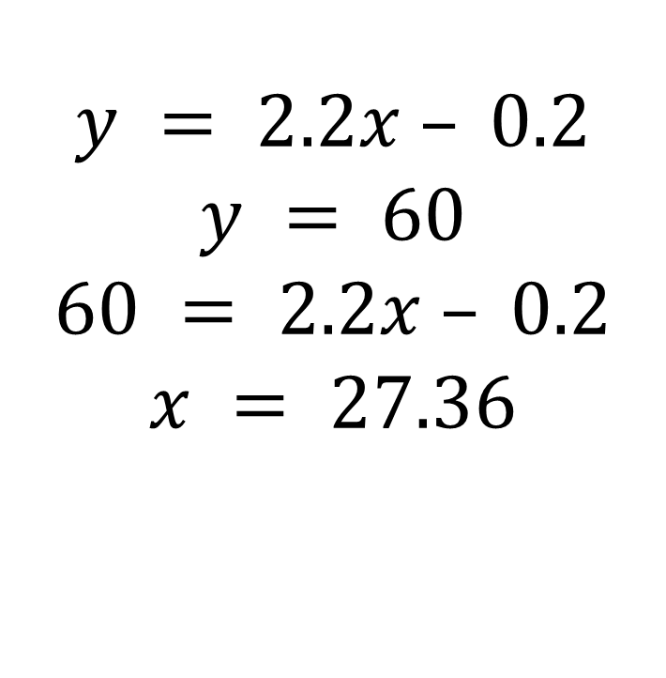
Nitrate Calibration Curve - Example
Now that we have calculated our estimated calibration curve equation, was can estimate the concentration of nitrate in the lab sample. For example, a typical seawater sample run on the instrument gives a peak area value of 60. Calculate the nitrate concentration for the typical seawater sample using the calibration curve equation.
$$y = 2.2x – 0.2$$
$$y = 60$$
$$60 = 2.2x – 0.2$$
$$x = 27.36$$

