Slide 1
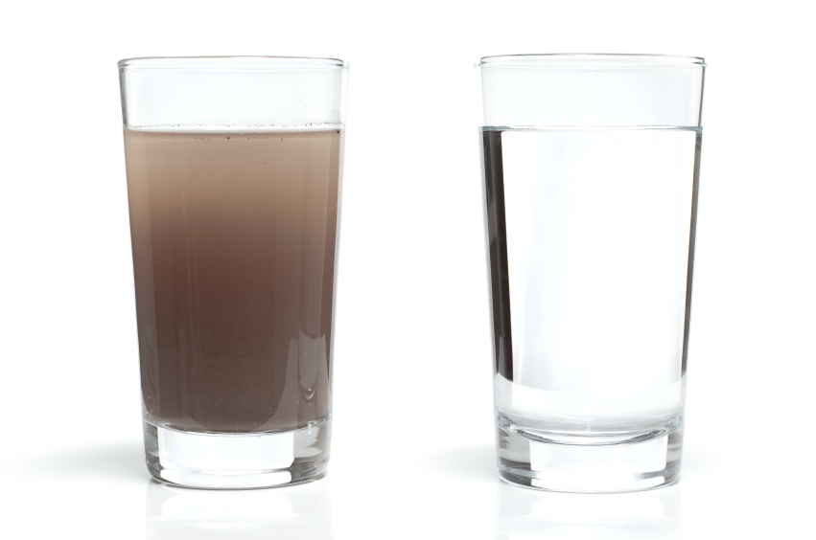
Nitrates – How Clean is the Water?
http://infinitewaterss.weebly.com/

Slide 2
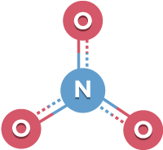
What are nitrates?
Nitrogen is found everywhere on earth
the air we breathe
the ground we walk on
the water we drink
Nitrogen can be in many different forms
One of these is nitrate
The nitrogen cycle
Nitrogen circles through different components of the earth in different forms
http://www.kinetico.com/blog/post/water-contaminant-nitrates.aspx

Slide 3
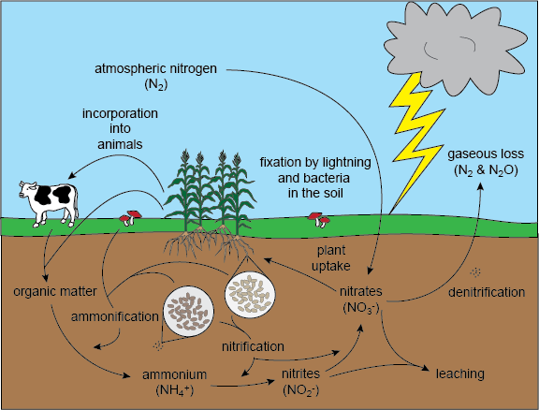
Where Do They Come From?
The nitrogen cycle!
Lightning and bacteria in the soil take nitrogen out of the air and put it in the ground
Plants use nitrogen to grow
Animals eat plants
Animals poop and plants die → the organic matter goes back to the earth
The nitrates in the earth are either used again or escape back into the sky

Slide 4
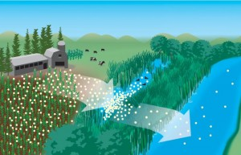
Why Are They In The Water?
Runoff!
When it rains, water carries dirt and debris from the land downhill
Nitrates that are on the ground run off with the water flowing into streams and rivers
The water eventually flows into steams, rivers, and bays
A main source of nitrates is fertilizer on farmer’s fields!
http://blogs.edf.org/growingreturns/2014/08/06/lake-eries-fertilizer-problem-isnt-over-but-were-working-on-it/

Slide 5
Why Does It Matter?
Nitrates are good for plants
When farmers put fertilizer on fields, some of the nitrates are incorporated into the plant
A lot of the fertilizer applied to the field sits in or on the soil and runs off into water bodies when it rains
Nitrates are bad for the health of fish and other organisms in the water
Too many nitrates = unhealthy stream and sick fish!
https://i.ytimg.com/vi/y1o1o4_Fh8w/hqdefault.jpg

Slide 6
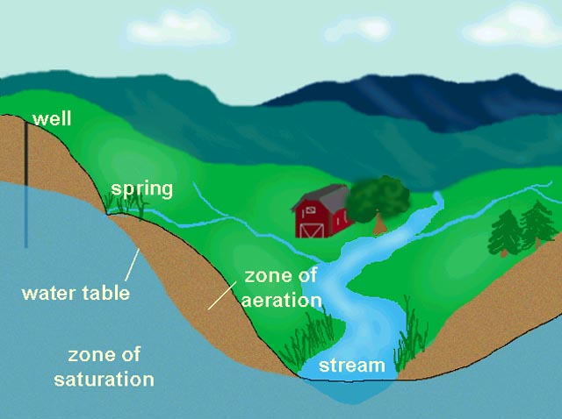
Why Does it Matter?
Too many nitrates are bad for aquatic ecosystems and other parts of the environment
Excess nitrates in drinking water can be bad for human health
Nitrate gets into drinking water as it is carried deep into soil, reaching underground water
The underground water is a source of drinking water for wells or water treatment plants
Drinking water sources can also be rivers and streams

Slide 7
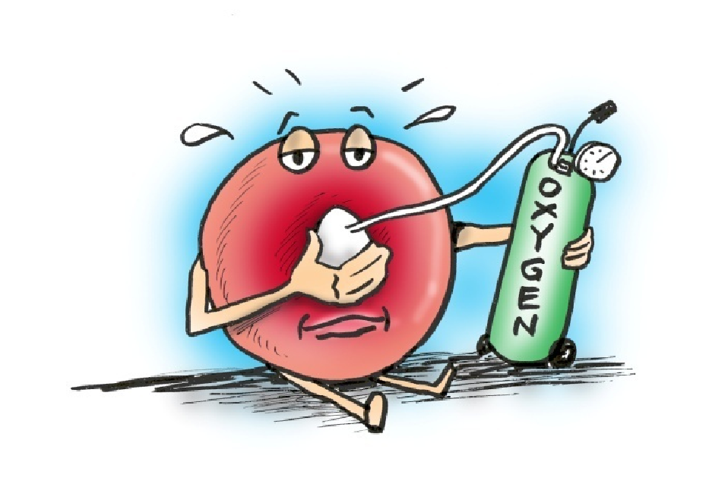
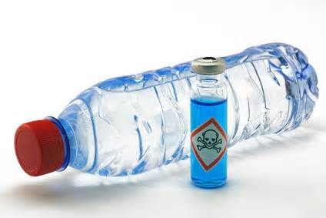
Nitrates and Human Health
Nitrates in water are particularly dangerous to babies and the elderly. It can cause methemoglobinemia, meaning that blood can’t carry sufficient oxygen to cells.
They can also cause nitrate poisoning which can lead to increased heart rate and respiration.

Slide 8
Why study Nitrates in Water??
Because they are important to our health and the health of the environment!

Slide 9
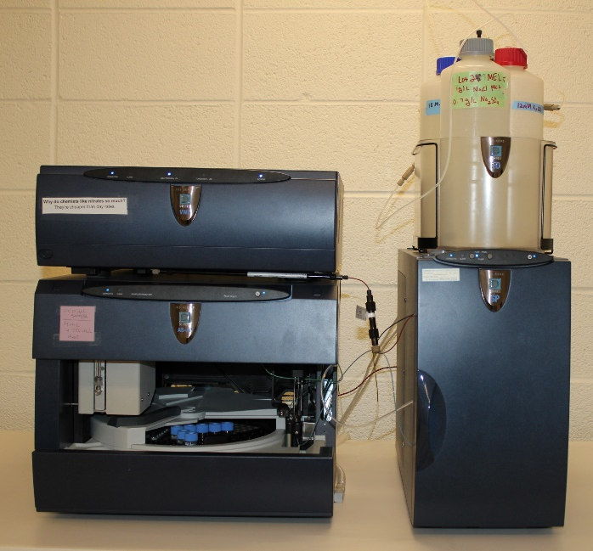
How do we detect them?
We cannot see nitrates
We use an instrument called an ion chromatograph
It separates everything in the water, and a special components detects how much nitrate there is

Slide 10
How Does It Work?
It separates what is in the water, just like when marker on paper gets wet and different colors separate
With a marker, your eyes detect colors – the instrument uses a special component to find nitrates, which we can’t see with just our eyes

Slide 11
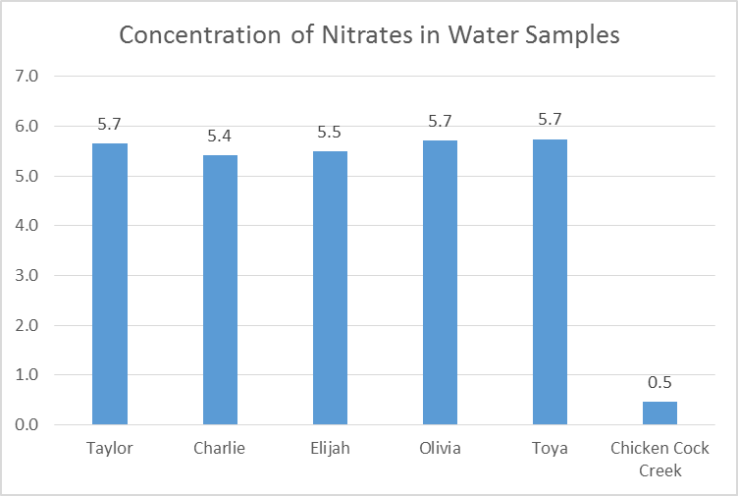
Your Results

Slide 12
What Do The Numbers Mean?
The government says that the water we drink can have up to 10 ppm nitrates
But DON’T drink the stream water – there are things other than nitrates that can be bad for you!
http://www.saltlesswater.com/water-hardness-scale/ and http://drawdoo.com/draw/how-to-draw-fish/

Slide 13
Questions?
http://www.clipartbest.com/question-cartoon

